Slide 1
AI For Everyone - Coursera

Slide 2
Machine Learning
Supervised Learning
Unsupervised Learning

Slide 3
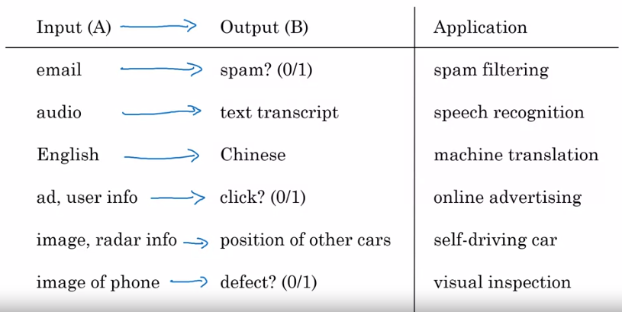
Supervised Learning

Slide 4
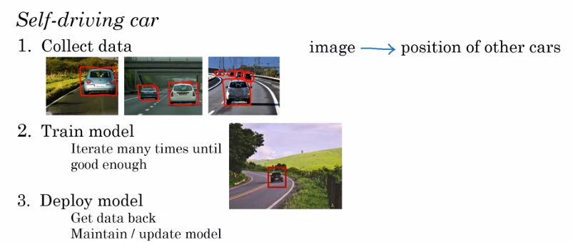
Key steps of a machine learning project
Collect data
Train model (iterates many times until good enough)
Deploy model

Slide 5
Key steps of a data science project
Collect data
Analyze data
Suggest hypotheses/actions :
- Deploy Changes
- Re-analyze new data periodically

Slide 6
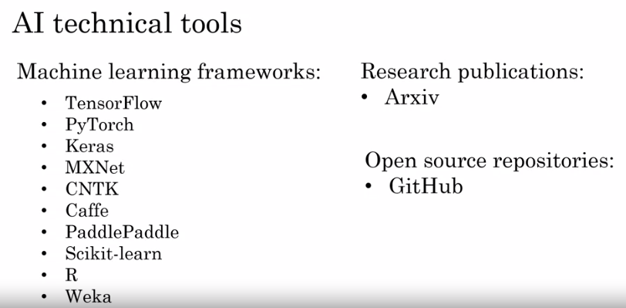

Slide 7
Cloud vs On-premises
Cloud deployments refer to if you rent compute servers such as from Amazon's AWS, or Microsoft's Azure, or Google's GCP in order to use someone else's service to do your computation.
Whereas, an On-prem deployment means buying your own compute servers and running the service locally in your own company.

